Slide 1
Chicago Crime Report
Sivabarani M
(MDT42)

Slide 2
Problem Description
The increasing complexity and volume of crime data present significant challenges for law enforcement agencies and policymakers.
Understanding patterns in criminal activities, identifying high-risk locations, and analyzing trends over time are crucial for effective decision-making.
However, the lack of accessible insights from raw crime data hinders the ability to allocate resources efficiently, predict future crime occurrences, and enhance community safety. Furthermore, assessing the effectiveness of arrests and understanding the impact of different crime types remain underexplored.
This project aims to address these challenges by analyzing the provided dataset to uncover actionable insights and trends, ultimately aiding in crime prevention and fostering safer communities.

Slide 3
Introduction
Crime data in Chicago is large and complex.
In this project, we want to clean this data and analyze it to find patterns, crime hotspots, and changes in crime over time.
This analysis can help law enforcement make better decisions.
I worked with crime data to find out where and when crimes happen. I also looked at how arrests are made and how law enforcement can improve. The main idea is to help police and policymakers make better decisions using the data.

Slide 4
Methodology overview
Cleaned the data and prepared it for analysis.
Storing Cleaned data in PostgreSQL.
Use PostgreSQL to get data in Power BI.
Used Exploratory Data Analysis (EDA) to find patterns using Power BI
Used Power BI to create visuals for the Interactive Dashboard.

Slide 5
Cleaning and Preprocessing
Handling Missing Values:
Crime data have missing values, errors, or incorrect formats.
Cleaning Process:
1. We filled in missing values with reasonable estimates
2. Ensured dates, times, and other data were properly formatted.
3. Fixed short-term in each column.
4. Example: “CRIM SEX ABUSE BY FAM MEMBER” to “CRIMINAL SEXUAL ABUSE BY
FAMILY MEMBER”
Data Structuring:
Once cleaned, we organized the data to make it easier for analysis and visualization.

Slide 6
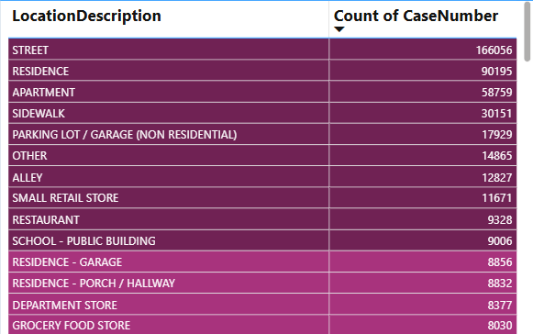
Crime Hotspot Identification
First, we wanted to identify the crime hotspots. These are areas with the highest crime rates. By looking at the data, we can focus law enforcement efforts on these areas to prevent crime
Based on the analysis, the highest number of crimes were reported in the street.

Slide 7
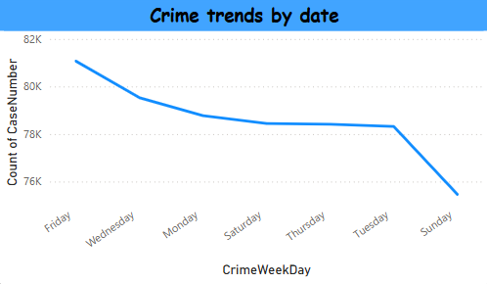
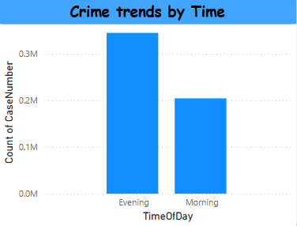
Trend and Seasonality Analysis
We also looked at crime trends whether crimes happen more on certain days, months, or even times of day. This helps us predict when and where more crimes might happen.
Based on the analysis, the highest number of crimes were reported on Friday and evening.

Slide 8
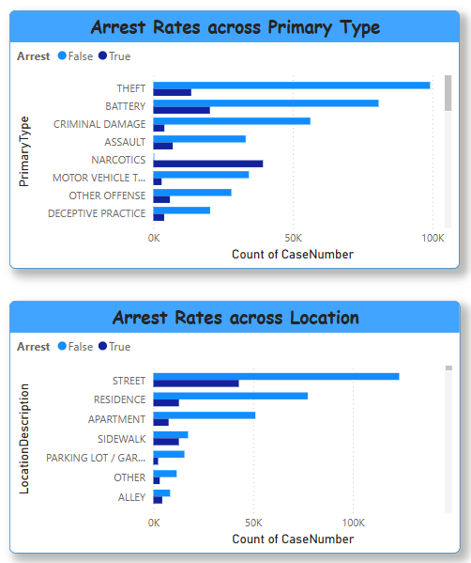
Arrest Efficiency Analysis
Another key focus was the efficiency of arrests. We examined how often arrests are made for different types of crimes and whether any type of crime needs more focus from law enforcement.
Our data showed that arrests for violent crimes were higher compared to property crimes and location.
The arrest theft was high.

Slide 9
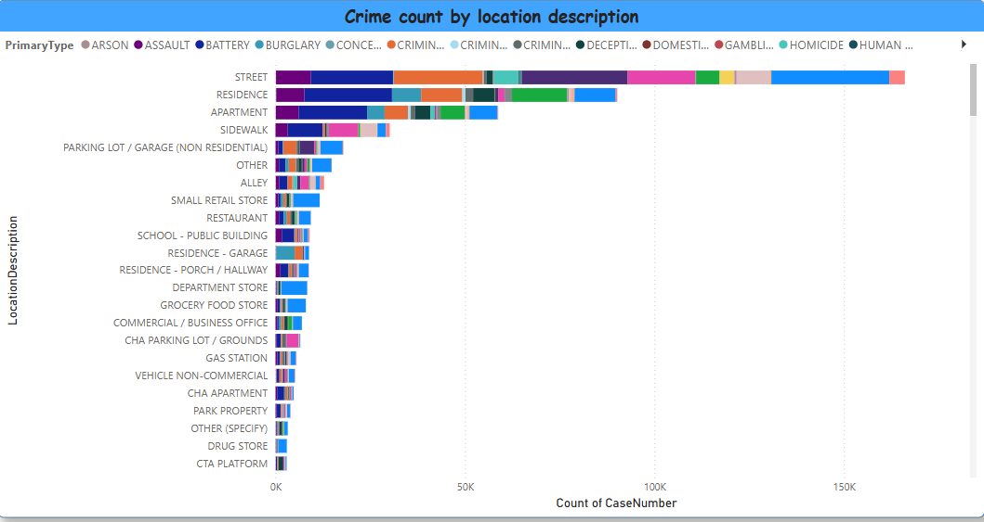
Neighborhood Safety Assessment
In this use case, I analyzed crime rates across different locations.
Based on analysis the street has the lowest safe score.
Most of the crimes happened in the street.
We can improve the safety on street areas

Slide 10
Crime Prediction and Prevention
From analyzing the data from 2019 to 2024(the last 5-year data), we found that the highest number of crimes occur at the beginning of the year and on the first day of each month.
Most crimes happen in the evening, particularly in street areas. The peak crime period is during the spring season, from March to June, with theft being the most common crime.
Additionally, crimes tend to increase on Fridays, following two days of holidays, possibly due to larger crowds and more opportunities for theft.
To reduce crime, we recommend increasing security measures in street areas, particularly during these high-risk times.

Slide 11
Power BI EXplanation

Slide 12
DAshboard
I've created two main slides for the dashboard: Dashboard and Dashboard Details.
In the Dashboard slide, I have included the counts for total crimes, severe crimes, non-severe crimes, the number of arrests, and the number of non-arrests.
The dashboard also includes interactive filters, allowing you to explore the data by Year, Crime Type (Primary Type), Location, Arrest Status, Domestic vs. Non-Domestic, and incidents of time Additionally,
by clicking the i icon next to the arrest rate, you'll be taken to the Dashboard Details page for more in-depth crime information. You can easily return to the main dashboard by clicking the back button.
On the Dashboard page, I’ve included several visual elements:
A Location Map to show where crimes are happening geographically.
A Donut Chart to visualize the distribution of crime types.
A Tree Map to provide detailed crime information.
A Stacked Bar Chart that displays crime trends across months
One of the most valuable features is the Tree Map, which allows us to identify areas with the highest crime rates and highlight the most common crime types in those areas.

Slide 13
Page details
On every page, you can view specific information by clicking on the legend values.
Trends Over Time:
This section displays crime trends in a line chart, broken down by year, month, and day.
We can filter by year to view crime trends on a yearly basis.
From this analysis, we can predict that most crimes happen at the beginning of the month.
Peak Crime Hours:
This heatmap shows the number of crimes reported each hour, broken down by day.
We can view the count of specific crime types that occurred during particular hours.
From this analysis, most crimes happen at midnight (12 AM). Theft and deceptive practices are the most common types of crimes.

Slide 14
Page details Cont…
Crime Hotspots:
This section presents a geographical map of crime locations, helping to identify high-risk areas.
I have also included a Risk Assessment table, where I've highlighted high-risk areas using color coding.
The colors represent the frequency of crimes, with the high-risk areas shown in a distinct color to indicate areas with the highest crime counts.
From this analysis, we can predict the highest crime count for each location.
Distribution of Crime Types:
This section displays the distribution of crime types across various locations using a horizontal bar chart.
Severity Analysis:
This section shows the severity of crimes. I have created a new column named "Severity" to categorize crimes as either "Severe" or "Non-severe" based on their primary type in DAX.
From this analysis, the count of theft is high.
We can filter by year to view crimes from specific years.

Slide 15
Page details Cont…
Arrest Rates:
On this page, I have added a donut chart showing the total number of arrests.
I have also calculated arrest rates across different locations, primary types, and time periods using a grouped chart.
From these charts, we can predict the arrest rate. In most cases, arrests occurred in about 50% of incidents, but in some cases, the arrest rate was as low as 20%
Domestic vs. Non-Domestic:
I have added a grouped chart to show the count of domestic and non-domestic crimes in each location.
From this analysis, it appears that domestic crimes are more likely to occur on the street.

Slide 16
Page details Cont…
Location Description:
I have created a stacked bar chart to visualize the distribution of each crime across different locations.
The colors are used to distinguish between the various crime types.
Based on analysis the street has the lowest safe score.
Most of the crimes happened in the street.
Seasonal Trends:
I have included line charts to show crime rates across different times of day, seasons, and periods.
For the season, I added a new column named "Season" using DAX code.
We can filter the crime data by year, location, primary type, and crime description.
From this analysis, most crimes occurred on
Fridays,
during the evening,
and in the spring season (from March to June) in Chicago.

Slide 17
POWerbi screenshots

Slide 18
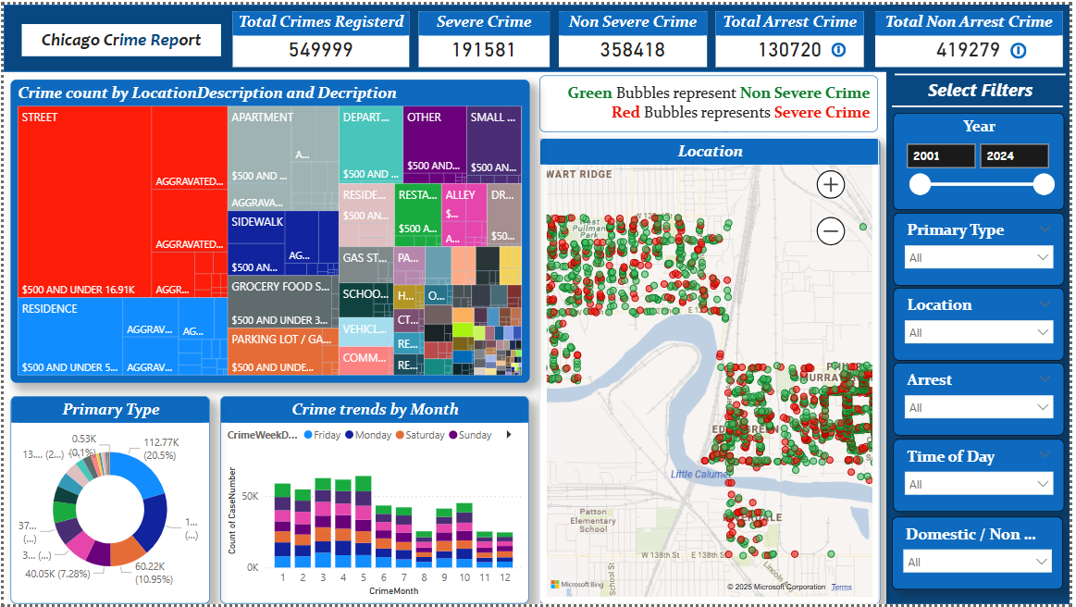
Dashboard

Slide 19
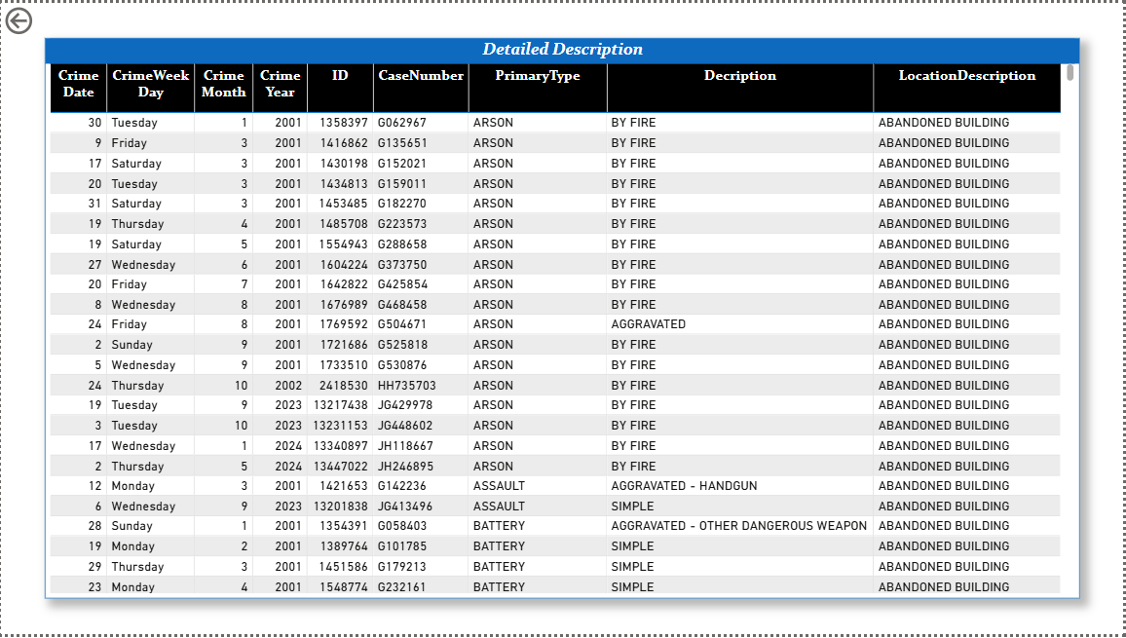
Dashboard Description

Slide 20
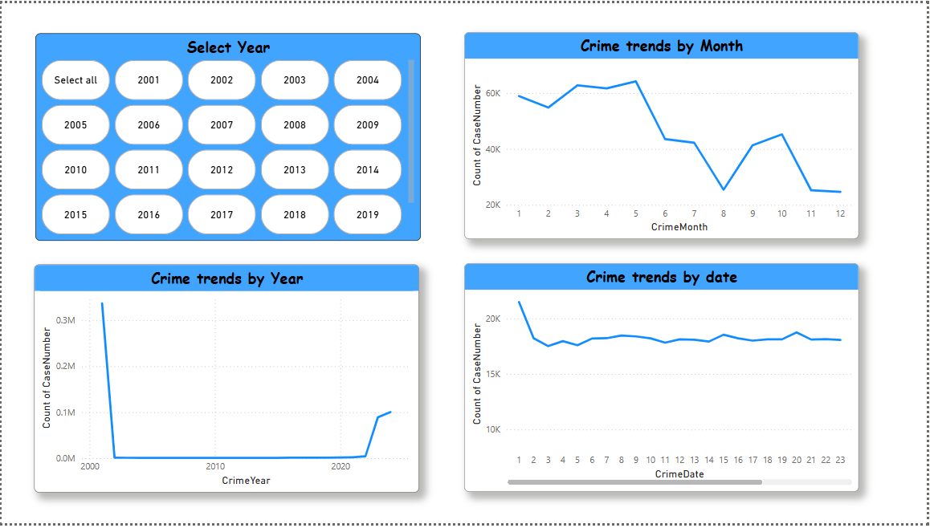
Crime Trends overtime

Slide 21
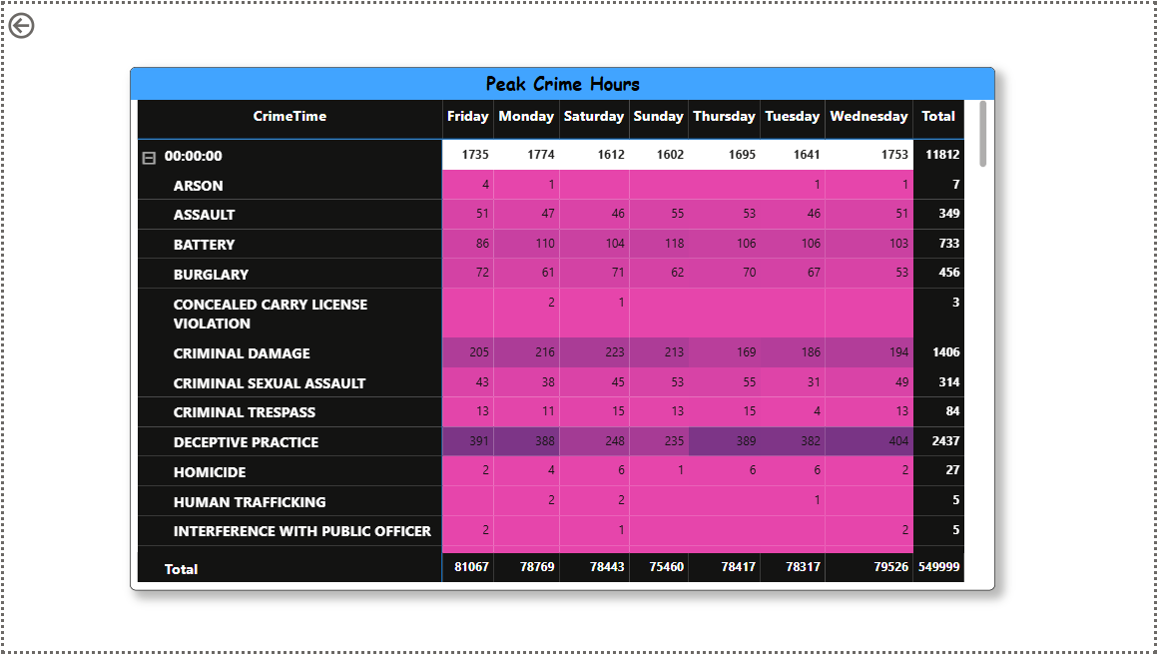
Peak Crime Hours

Slide 22
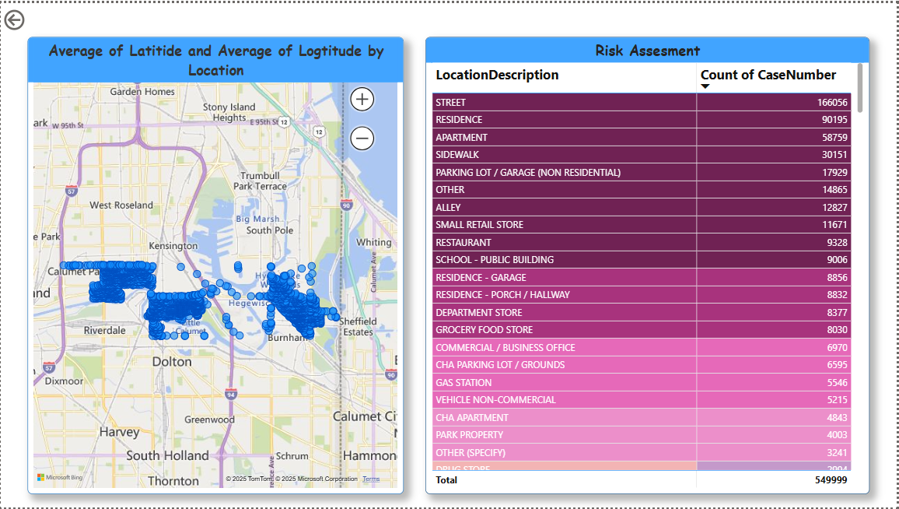
Crime Hotspots

Slide 23
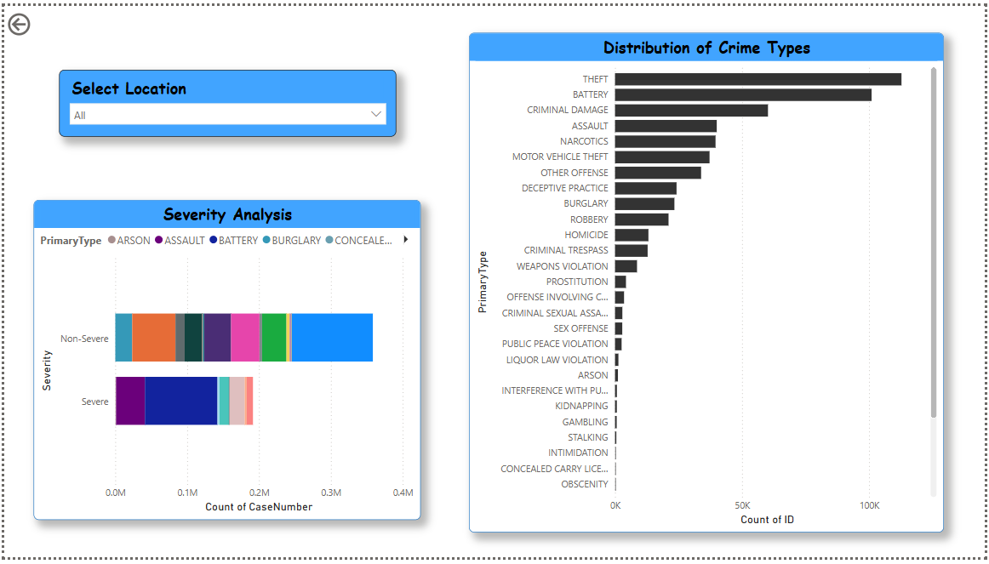
Distribution of Crime types

Slide 24
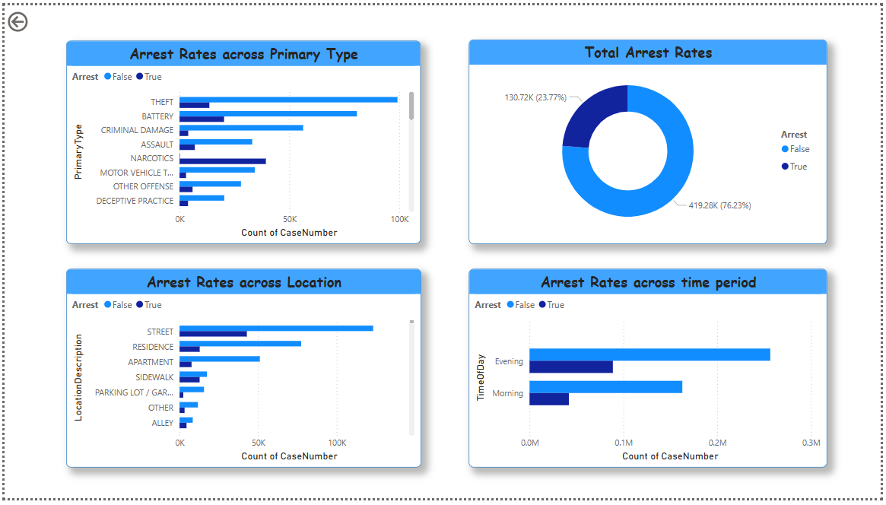
Arrest Rates

Slide 25
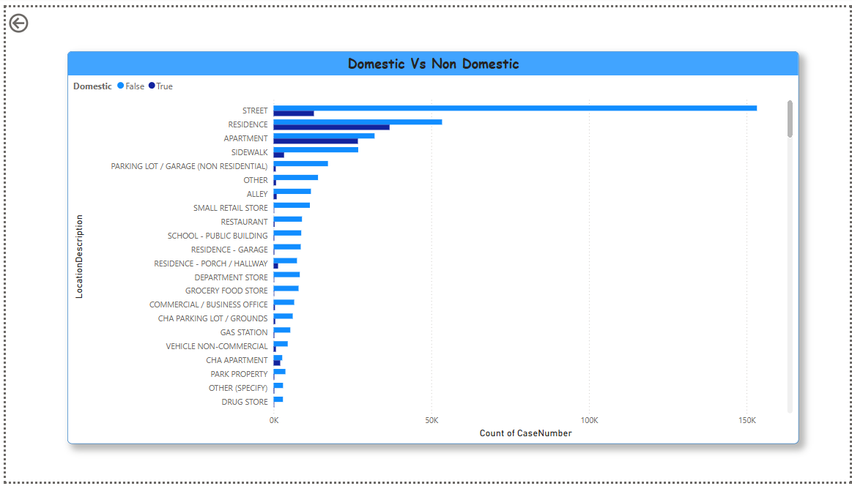
Domestic Non Domestic

Slide 26
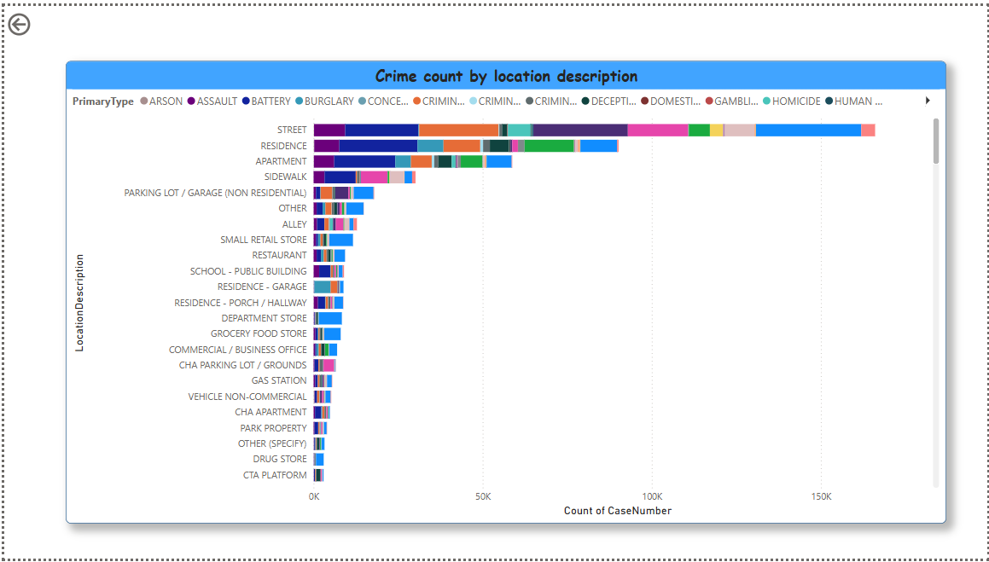
Location Description

Slide 27
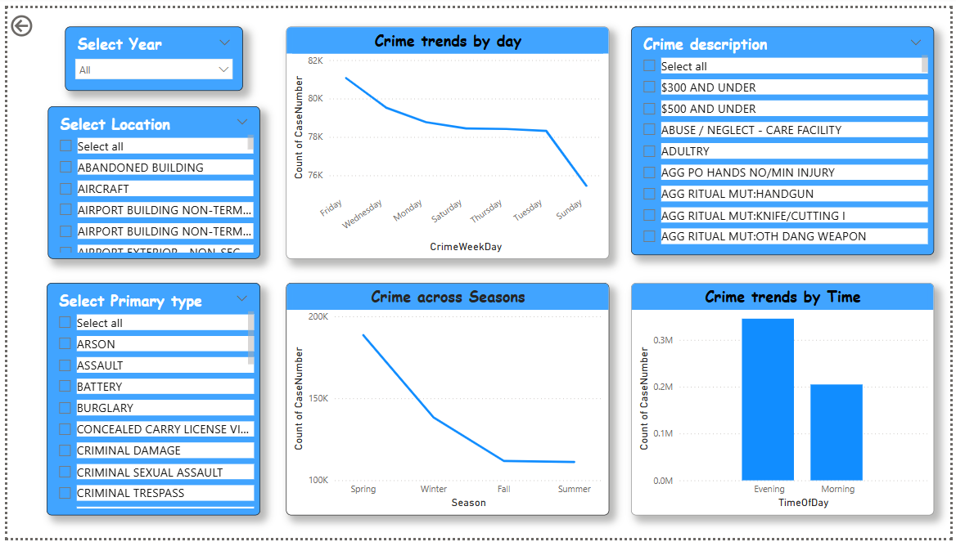
Seasonal Trends

Slide 28
Thank YOU!!!

